Slide 1
Multi-omics Boot Camp
Analysis of Omics Data for Research Studies
Latent Mediation

Slide 2
Goals
Understand the concept of mediation analysis and its application in omics study
Understand the statistical modeling of different mediation analysis framework, including
Simple mediation analysis (one exposure, one mediator, and an outcome)
Analysis with multiple mediators
Analyses with multiple exposure.
Approaches that estimate latent variables.
LUCID
Apply the methods mentioned above in R and be able to interpret the results

Slide 3
High Dimensional Mediation
Omic
G/E
Y
E
E
E
E
3

Slide 4
Estimate Latent Variables
Dimension reduction before mediation
Omic
L
G/E
Y
E
E
E
E
4

Slide 5








Mediation Analysis with a Latent Mediator
$$M_{1}$$
$$M_{2}$$
……
$$M_{p}$$
$$M_{p}= δ_{0p}+δ_{1p}L$$
Mediator Model
(Model for latent mediator)
L
Outcome Model
(Single model for Latent Mediator
$$L= α_{0}+α_{1}X$$
$$Y= γ_{0}+β_{1}^{∗}X+γ_{1}L$$
$$X$$
$$Y$$
Albert et al. 2016.

Slide 6
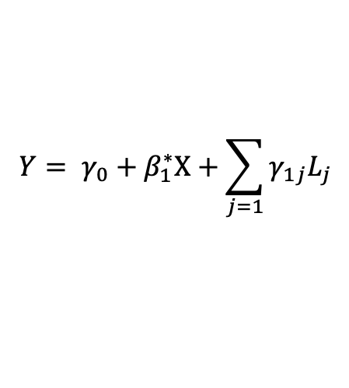

Mediation Analysis with a Latent Mediator
$$M_{1}$$
$$M_{2}$$
……
$$M_{p}$$
$$M_{p}= δ_{0p}+δ_{1p}L_{j}$$
Mediator Model
(Model for latent mediator)
Outcome Model
(Single model for Latent Mediator
L₁
L_{j}
L_{J}
…
…
$$L= α_{0}+α_{1}X$$
$$Y= γ_{0}+β_{1}^{∗}X+\sum_{j=1}{γ_{1j}L_{j}}$$
$$X$$
$$Y$$
The total number of J latent variable is pre-selected but also include a penalty.
Derkach et al. 2019.

Slide 7
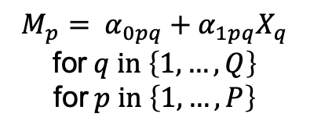

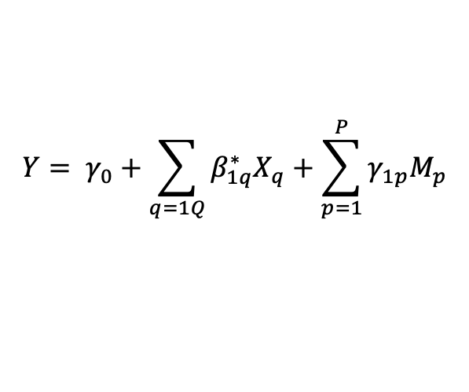




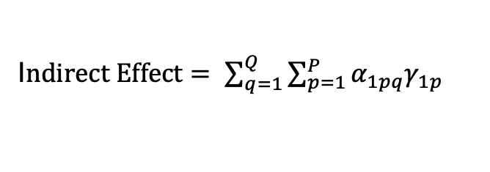
Pairwise Mediation Models
Mediator Model
$P$ variables
Outcome Model
$$M_{p}= α_{0pq}+α_{1pq}X_{q}$$
$$\text{for} q \text{in} \left\{1, …, Q\right\}$$
$$\text{for} p \text{in} \left\{1, …, P\right\}$$
$$M$$
$$Y= γ_{0}+\sum_{q=1Q}{β_{1q}^{∗}X_{q}}+\sum_{p=1}^{P}{γ_{1p}M_{p}}$$
$$X$$
$$Y$$
$Q$ variables
I$ndirect Effect= \sum_{q=1}^{Q}{\sum_{p=1}^{P}{α_{1pq}γ_{1p}}}$

Slide 8






























Pairwise Mediation Models
$$α_{11}$$
$$α_{12}$$
$$α_{1q}$$
$$γ_{1}$$
$$α_{21}$$
$$α_{22}$$
$$α_{2q}$$
$P$ variables
$$γ_{2}$$
$$…$$
$$α_{31}$$
$$α_{32}$$
$$α_{3q}$$
$$M$$
$$γ_{3}$$
Numerous parameters
$$α_{41}$$
$$α_{42}$$
$$α_{4q}$$
$$γ_{4}$$
$$…$$
$$…$$
$$…$$
$$…$$
$$α_{p1}$$
$$α_{p2}$$
$$α_{PQ}$$
$$γ_{P}$$
$$β_{1}^{∗}$$
$$β_{2}^{∗}$$
$$X$$
$$β_{3}^{∗}$$
$$Y$$
$$β_{4}^{∗}$$
$Q$ variables
$$…$$
$$β_{Q}^{∗}$$

Slide 9
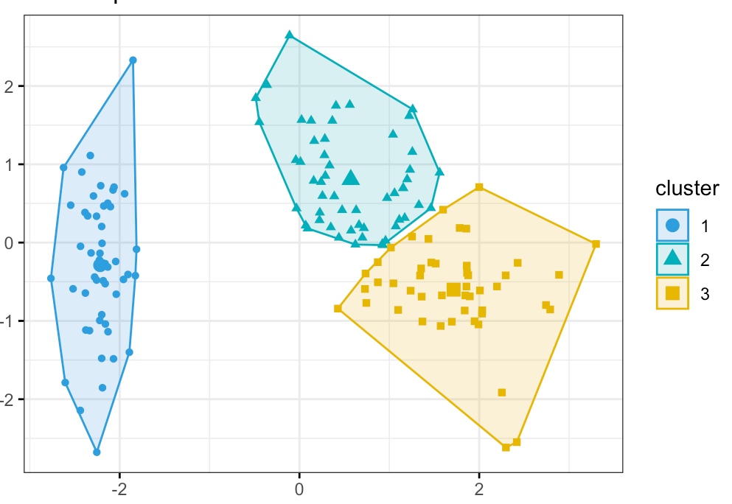





Latent Clustering
Idea: combine mediation type analysis with clustering analysis
$$M$$
Omics feature 2
Latent cluster
$$L_{1}$$
Omics feature 1
$$X$$
$$L_{2}$$
$$Y$$
$$L_{3}$$

Slide 10


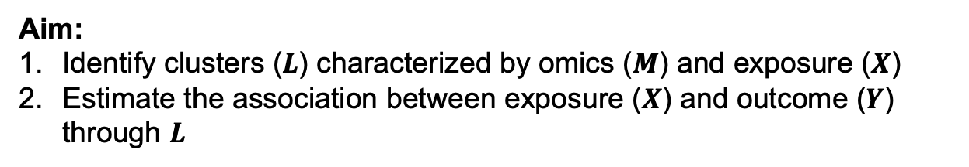


Latent Unknown Clustering Integrating omics Data
Aim:
Identify clusters ($L$) characterized by omics ($M$) and exposure ($X$)
Estimate the association between exposure ($X$) and outcome ($Y$) through $L$
$$M$$
Omic effect
Exposure effect
$$L$$
$$Y$$
Outcome effect
$$X$$

Slide 11
LUCID: Joint Modeling via a Latent Cluster
δ
M
Σ
β
E/G
L
Y
γ
Peng et al. Bioinformatics 2019

Slide 12
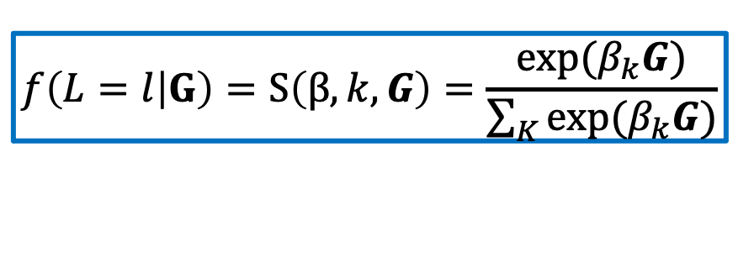
LUCID: Joint Modeling via a Latent Cluster
$$f\left(L=l | G\right)=S\left(β,k,G\right)=\frac{\text{exp}(β_{k}G)}{\sum_{K}{\text{exp}(β_{k}G)}}$$
δ
M
Σ
β
E/G
L
Y
γ
Peng et al. Bioinformatics 2019

Slide 13
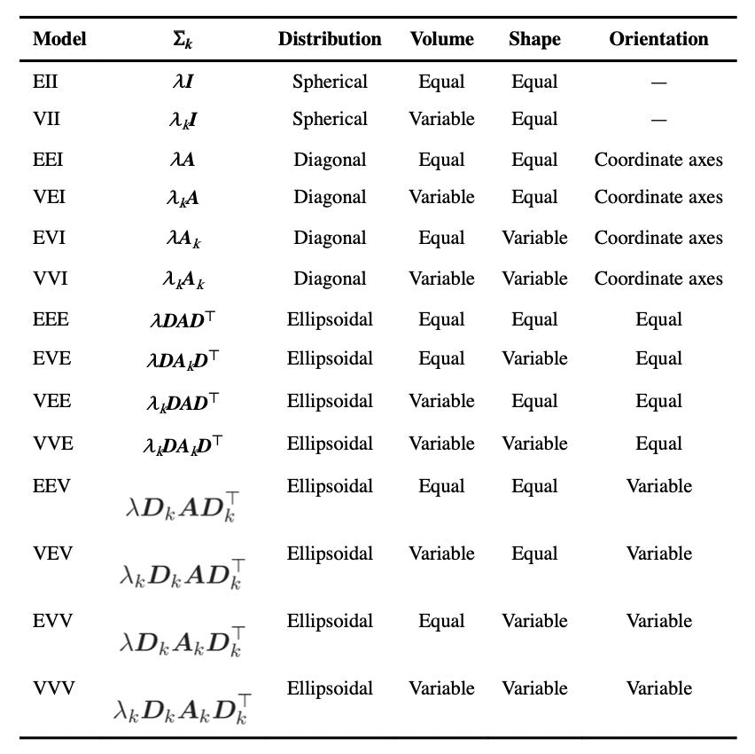

LUCID: Joint Modeling via a Latent Cluster
$$f\left(L=l | G\right)=S\left(β,k,G\right)=\frac{\text{exp}(β_{k}G)}{\sum_{K}{\text{exp}(β_{k}G)}}$$
δ
M
$$f\left(Z | L=l\right)=MVN(L_{K}δ_{K},Σ_{K})$$
Σ
β
E/G
L
Y
γ
Peng et al. Bioinformatics 2019

Slide 14
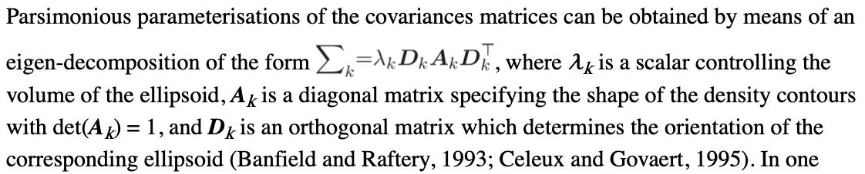
LUCID: Joint Modeling via a Latent Cluster
$$f\left(L=l | G\right)=S\left(β,k,G\right)=\frac{\text{exp}(β_{k}G)}{\sum_{K}{\text{exp}(β_{k}G)}}$$
δ
M
$$f\left(Z | L=l\right)=MVN(L_{K}δ_{K},Σ_{K})$$
Σ
β
E/G
L
Y
γ
Peng et al. Bioinformatics 2019

Slide 15
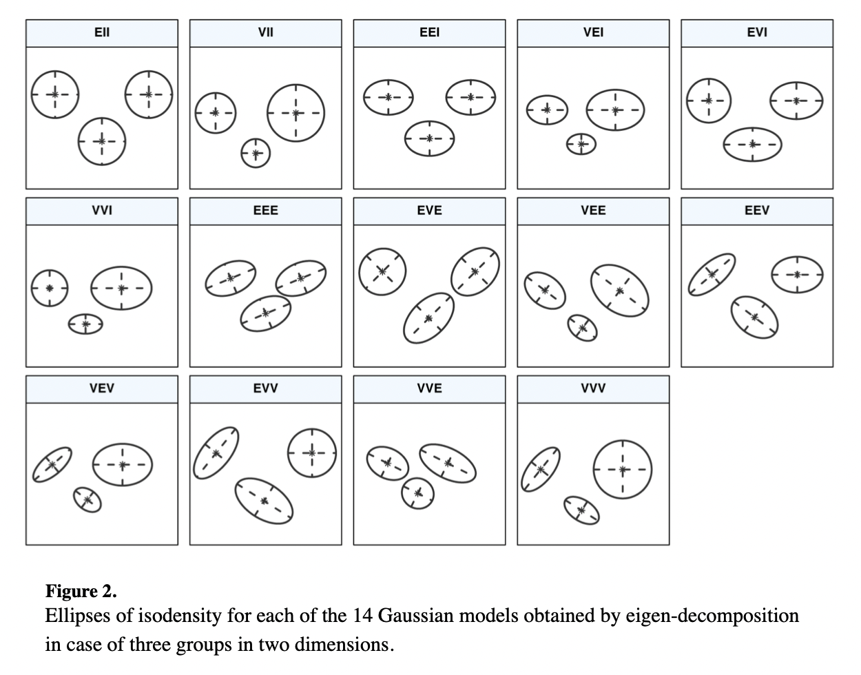
LUCID: Joint Modeling via a Latent Cluster
$$f\left(L=l | G\right)=S\left(β,k,G\right)=\frac{\text{exp}(β_{k}G)}{\sum_{K}{\text{exp}(β_{k}G)}}$$
δ
M
$$f\left(Z | L=l\right)=MVN(L_{K}δ_{K},Σ_{K})$$
Σ
β
E/G
L
Y
γ
Peng et al. Bioinformatics 2019

Slide 16
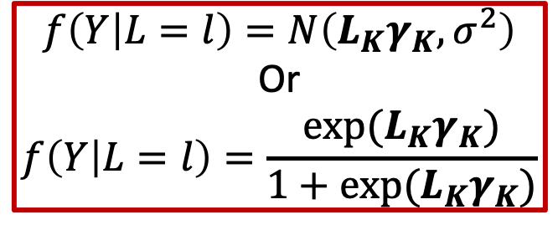
LUCID: Joint Modeling via a Latent Cluster
$$f\left(L=l | G\right)=S\left(β,k,G\right)=\frac{\text{exp}(β_{k}G)}{\sum_{K}{\text{exp}(β_{k}G)}}$$
δ
M
$$f\left(Z | L=l\right)=MVN(L_{K}δ_{K},Σ_{K})$$
Σ
$$f\left(Y | L=l\right)=N\left(L_{K}γ_{K},σ^{2}\right)$$
Or
$$f\left(Y | L=l\right)=\frac{exp⁡(L_{K}γ_{K})}{1+exp⁡(L_{K}γ_{K})}$$
β
E/G
L
Y
γ
Peng et al. Bioinformatics 2019

Slide 17

LUCID: Joint Modeling via a Latent Cluster
$$f\left(L=l | G\right)=S\left(β,k,G\right)=\frac{\text{exp}(β_{k}G)}{\sum_{K}{\text{exp}(β_{k}G)}}$$
δ
M
$$f\left(Z | L=l\right)=MVN(L_{K}δ_{K},Σ_{K})$$
Σ
$$f\left(Y | L=l\right)=N\left(L_{K}γ_{K},σ^{2}\right)$$
Or
$$f\left(Y | L=l\right)=\frac{exp⁡(L_{K}γ_{K})}{1+exp⁡(L_{K}γ_{K})}$$
β
E/G
L
Y
γ
$$\log{L(Θ)}=\sum_{i=1}^{n}{\log{S(β,k,G_{i})}}+\sum_{i=1}^{n}{\log{φ(M_{i};δ_{j},Σ_{j})}}+\sum_{i=1}^{n}{\log{φ(Y_{i};γ_{j},σ_{j})}}$$
Peng et al. Bioinformatics 2019

Slide 18
Features of LUCID
Inclusion of covariates in G → L and L → Y.
Use BIC to determine number of clusters.
Continuous and binary outcomes.
Supervised and unsupervised analysis.
Prediction of clusters and outcomes with new data.
Peng et al. Bioinformatics 2019
18

Slide 19
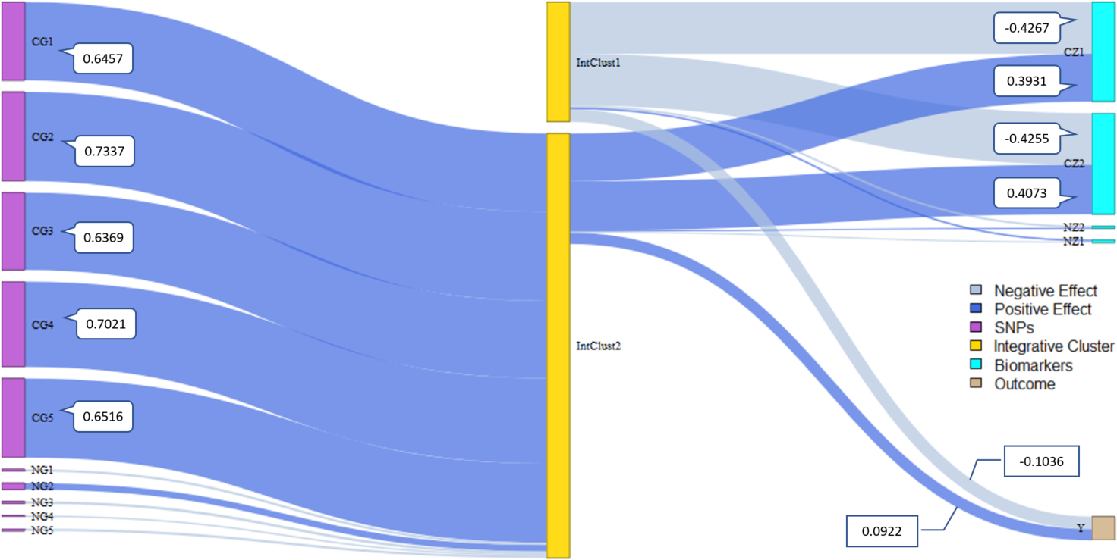
Simulation Example
Links: light blue = negative effect; dark blue = positive effect;
Width: effect size. IntClust: integrative cluster.

Slide 20
Varying Biomarker Effects
δ
M
Σ
β
G
L
Y
γ

Slide 21
Varying Genetic Effects
δ
M
Σ
β
G
L
Y
γ

Slide 22
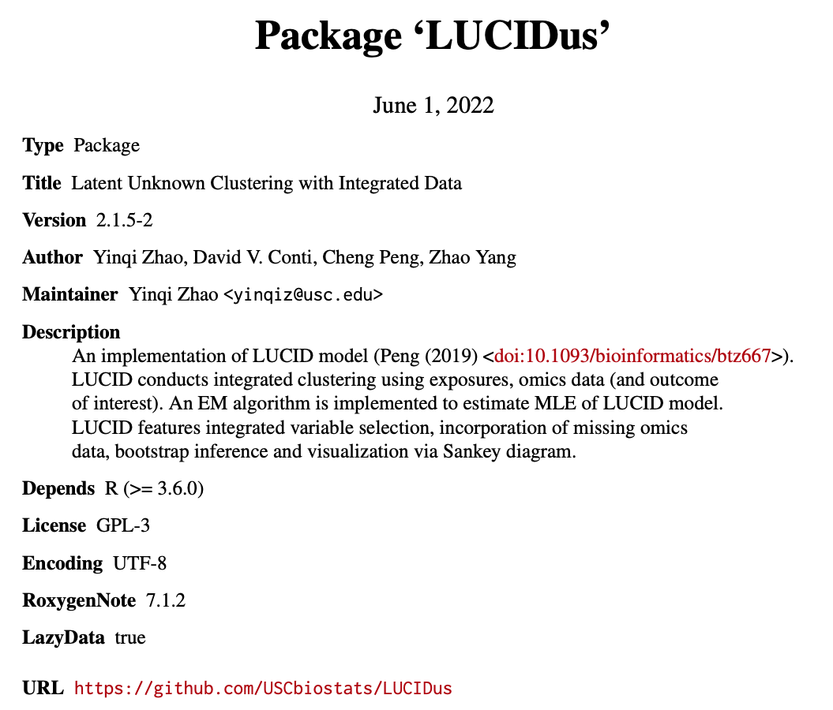
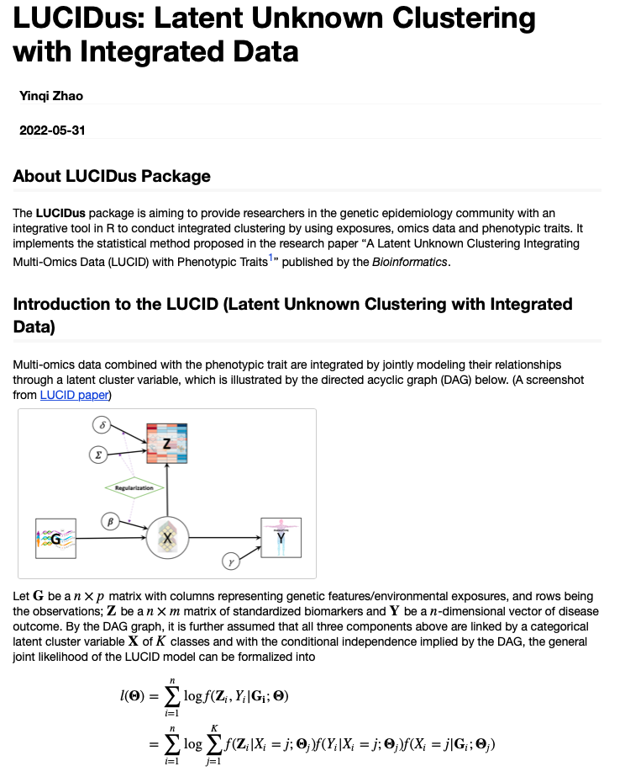
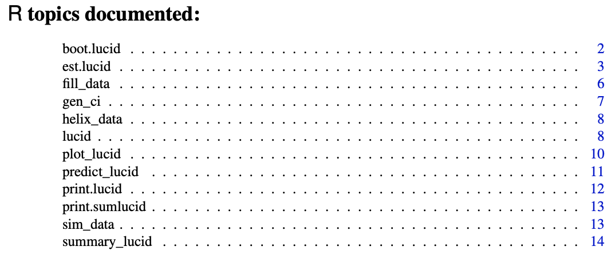
LUCIDus R Package
Peng et al. Bioinformatics 2019
22

Slide 23
Additional Features of LUCID
Regularization for high dimensional G/E and omic data.
Parallelized grid search for tuning parameters.
Allows for missing values in omic data.
Inference on parameters estimates.
Peng et al. Bioinformatics 2019
R package: LUCIDus
23

Slide 24
Labs
Mediation Part 1: “Simple” Mediation
Mediation Part 2: High Dimensional Mediation
HIMA
BAMA
Meet in the Middle
Mediation Part 3: LUCID (Combined Session for Lecture and Lab)

